Slide 1
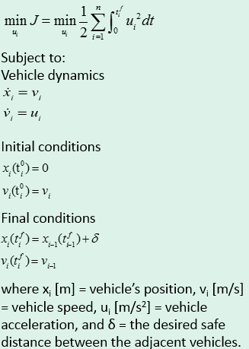
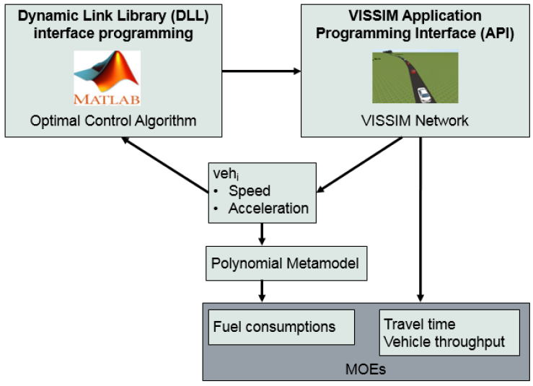
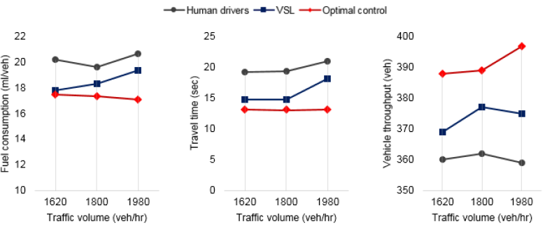
Development and Evaluation of Speed Harmonization using Optimal Control Theory:
A Simulation-Based Case Study at a Speed Reduction Zone
Seongah Hong, Andreas A. Malikopoilos, Joyoung Lee, and Byungkyu Brian Park
Problem Formulation
Simulation Framework
Results

Slide 2
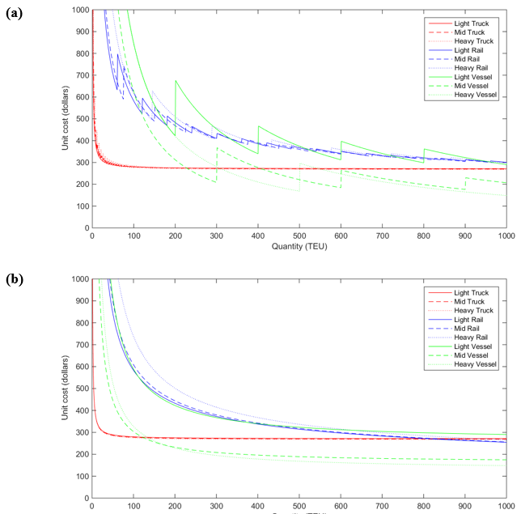
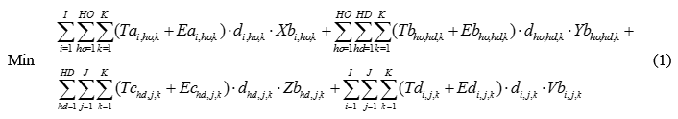
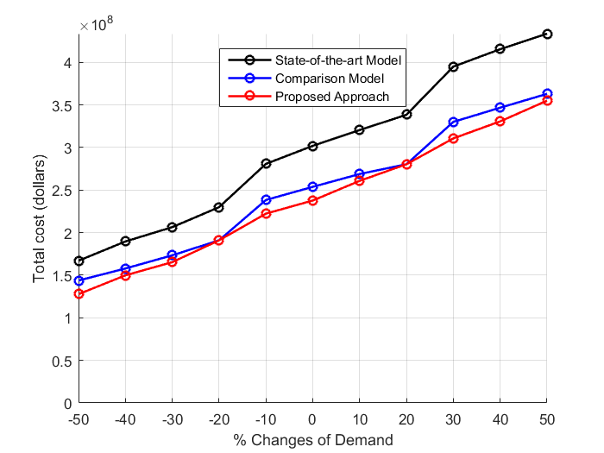
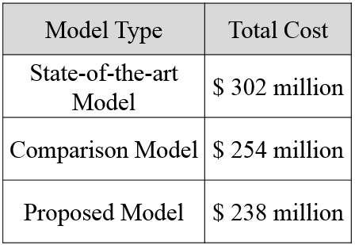
Optimization of Multimodal Network System for Environmental Sustainability incorporating Economies of Scale
Seongah Hong, Jia Hu, and Byungkyu Brian Park
Economies of Scale in Logistics
Mixed Integer Linear Programming Model
Evaluation results

